Slide 1
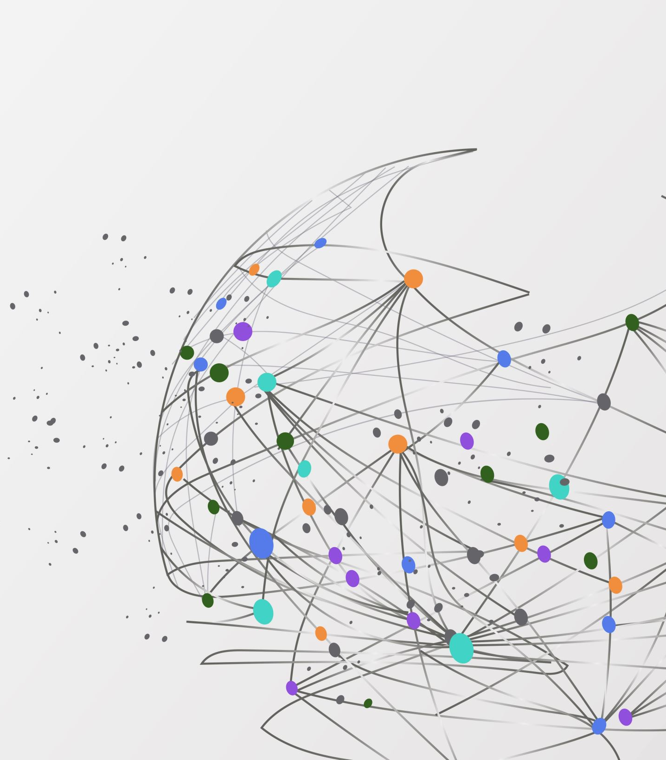
Data Platform Design for healthcare research
Xiang Li
17/03/2023

Slide 2

Content
Objective
Potential Audience & Stakeholders
Design of Schema
Data Privacy and Security
Extract, Transform, and Load (ETL)
Monitor and Maintain
Future Work

Slide 3
Objective
Identify how diseases begin and progress
Integration of genetics and healthcare data
predicted outcome: research-ready, well-curated and well-documented data

Slide 4
Potential Audience
Researchers (bioinformatics scientists，
surgeon, oncologists, etc.)
Managers in NHS
Public
Funding Organisations
Government Health Sectors

Slide 5
Potential Stakeholders
IT (database establishment and maintain)
Public (disease trend)
Researchers (needed data)

Slide 6
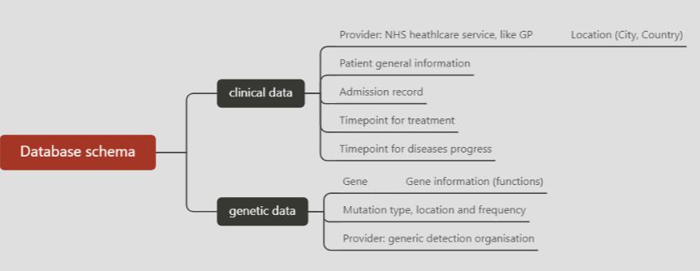
Design of Schema

Slide 7
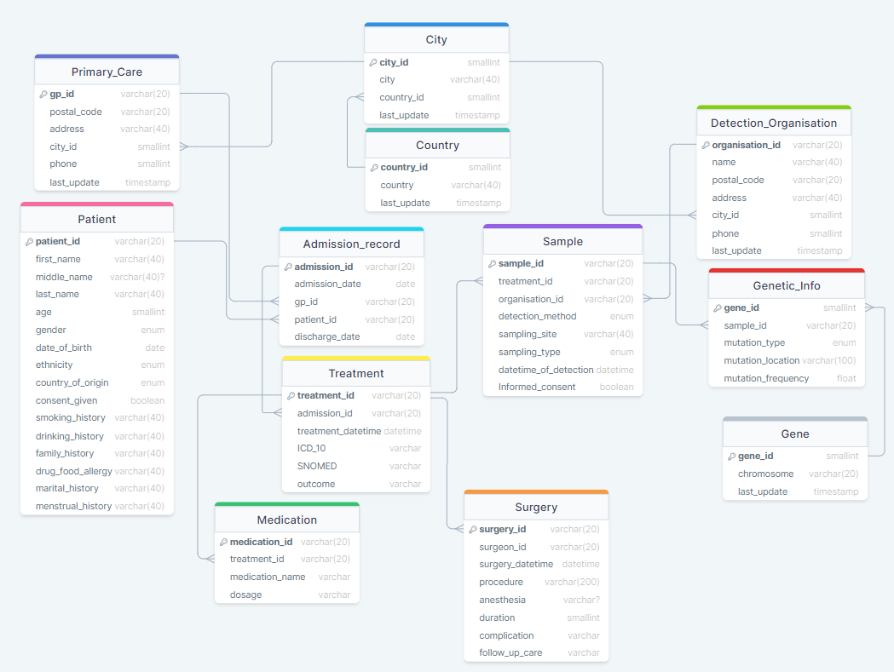
Design of schema

Slide 8
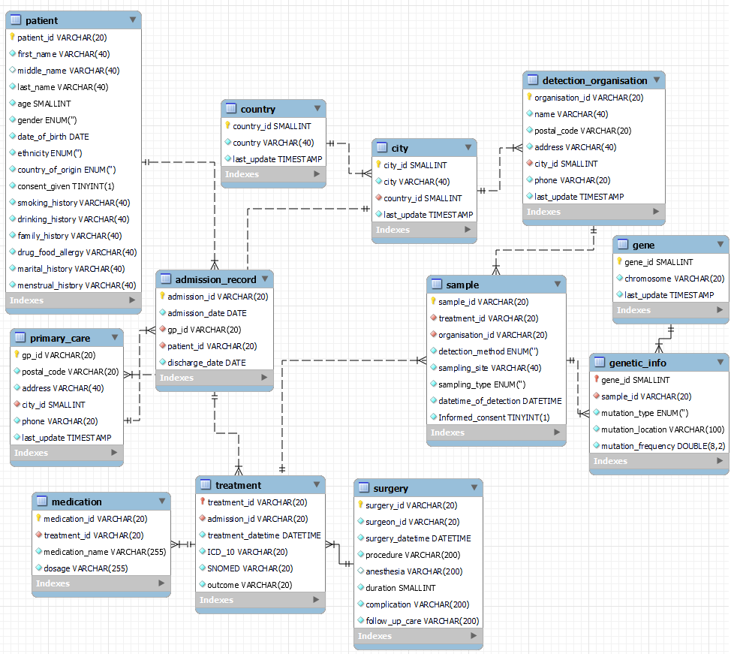
EER Diagram

Slide 9
Data Privacy and Security
ethical considerations
obtaining patient consent
maintaining data privacy and security
comply with the legal and ethical guidelines

Slide 10
Information Governance
the NHS Act 2006
the Health and Social Care Act 2012
the Data Protection Act
the Human Rights Act
Reference: https://www.england.nhs.uk/ig/about/
https://www.england.nhs.uk/ig/ig-resources/

Slide 11
Possible Solution – “secondary uses”
“only use data that do not identify individual patients unless they have the consent of the patient themselves”.
Obtain the appropriate consent from patients
de-identify the data to protect patient privacy
ensure data is only used for approved purposes

Slide 12

Possible Solutions – Technical Aspects
Data anonymization
Data encryption
Data access control
Data masking
…

Slide 13
Extract, Transform and Load (ETL)
Data Resource: Electronic Health Records (EHRs)
obtain permission from administrators and patients
establish the relationships between EHR and the database (needed data)
extract data from EHRs (APIs, SQL)
transform: revise the message formats and map coding systems (Apache Spark)
load: import data and ensure the data is complete and accurate
Reference: Tang, P.C. and McDonald, C.J. (2006). Electronic Health Record Systems. Health Informatics, pp.447–475.
‌

Slide 14
ETL
Data Source: genetic data
extract data from the genetic database (APIs or data export tools)
transform data to make sure it is compatible with the designed schema
load the transformed data

Slide 15

Monitor and Maintain
Set up scheduled ingestion of data from the EHR databases to an analytical database (Airflow)
at the correct time
with a specific interval
in the right order

Slide 16
Future Work
Make sure there is a separate database for analytics (Or Views)
Optimise the needed columns (add new tables or columns)

